Slide 1
HyperParameter Tuning
Hyper:Beyond Parameter: Variable Tuning: Adjusting
Adjusting the Variables beyond the Model’s learning process

Slide 2
Hyperparameter tuning is the process of optimizing the external configuration (hyperparameters) of a machine learning model to improve its performance and generalization on unseen data.
Questions to be Raised in your Minds:
What are hyperparameters?
What is the difference between the parameters and hyperparameters?
Is tuning necessary to the hyperparametrs?
What are the needs of hyperparameter tuning?
Where we are going to use this Hyperparameter tuning?
How we are going to identify the necessity of tuning the hyperparametrs?

Slide 3
Difference Between Parameters and Hyperparameters
Parameters
Parameters are the internal variables of the model that are learned from the training data
These are updated during the training process to minimize the loss function.
These are updated during the training process to minimize the loss function.
Training: Parameters are learned automatically by the model using optimization algorithms (like gradient descent).
Examples: Weights and biases in neural networks, coefficients in a linear regression model.
Hyperparameters
The external configurations that govern the model training process but are not learned from the data.
They are set by the user before the learning process begins.
Training: Hyperparameters are not learned by the model and need to be set manually, often through methods like grid search or random search.
Role: They control how the model is trained and influence the training behavior and efficiency, indirectly affecting model performance.
Examples: Learning rate, batch size, number of layers in a neural network, number of epochs, dropout rate.

Slide 4

Knobs
Everyone calls me Radio, But Why I am here??
If you observe,the knobs of the radio works as external agents that helps to adjust the frequency
Likewise, The hyperparameters also external agents that can adjusted by the developer to……????

Slide 5
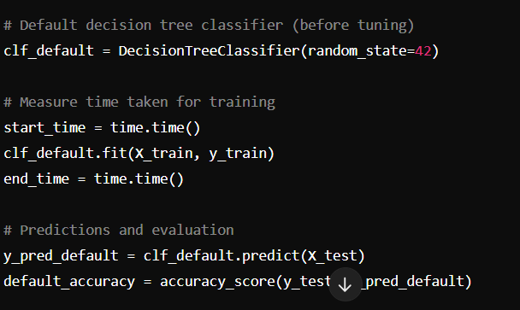
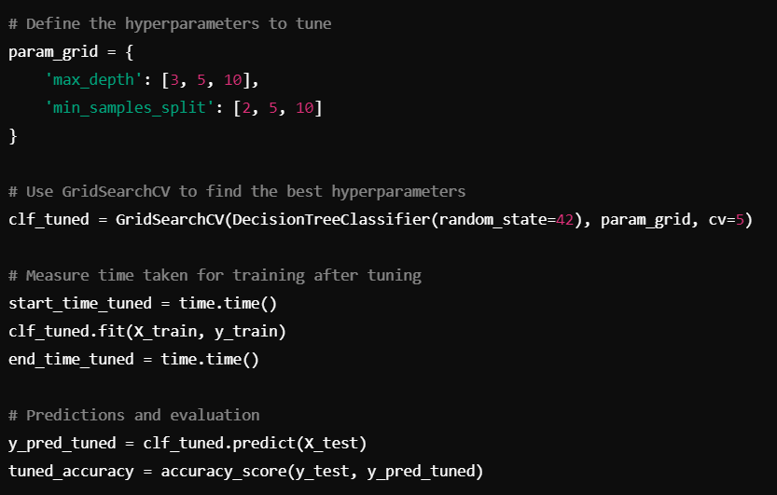
What are the needs of Hyperparameter tuning?
Before tuning
After tuning
Accuracy: Around 91-93% (This will depend on the random split and data)
Training Time: Time taken by the default model.
Tuned Accuracy: Improved accuracy, usually a few percent better (e.g., 95-97%).
Tuned Training Time: Slightly longer because of the grid search, but still within acceptable limits.
Best Parameters: Displays the best hyperparameters chosen by GridSearchCV, like max_depth and min_samples_split.

Slide 6
Use of Hyperparametrs tuning in different domains:
Machine Learning:
Supervised Learning:learning rate, regularization, batch size, and number of epochs.
Unsupervised Learning:the number of clusters in k-means, the number of components in PCA.
Deep Learning:
Neural Networks:no of layer’s ,no of neurons ,dropout rates, activation functions ,and learning rates
Recurring Neural Networks:sequence length, batch size, and learning rate is crucial for time series forecasting, language models, and speech recognition tasks.
Natural language Processing:
Transformer Models:attention heads, the size of embeddings, and learning rates.
Text Classification: number of epochs, learning rates, and dropout rates.
Computer Vision:
Image Classification:kernel size, number of filters, and learning rate to improve model accuracy.
Generative models: number of latent dimensions, learning rate, and batch size are key for training GANs.
Reinforcement Learning:
Policy Optimization:exploration rate, learning rate, and discount factors are crucial in reinforcement learning tasks.
Deep Q-Networks (DQN):Tuning the target update frequency and learning rate helps in faster convergence of DQN algorithms.

Slide 7
How we are going to identify the necessity of tuning the hyperparametrs?
Common Indicators for Hyperparameter Tuning Necessity:
Low Accuracy: Model accuracy on validation/test data is significantly lower than expected.
Overfitting: High training accuracy but low validation/test accuracy.
Underfitting: Low accuracy on both training and validation/test data.
Learning Curves: Training loss decreases while validation loss increases.
Sensitivity Analysis: Significant performance changes with small hyperparameter adjustments.
Cross-Validation: Fluctuating performance across different folds.
Baseline Comparison: More complex models underperform compared to simpler baseline models.
Early Stopping: Training stops early due to overfitting indications.
Domain Knowledge: Understanding of the problem domain suggests specific hyperparameters need tuning.

